Slide 1
IMAGES TO SMILES CONVERSION
By:
Abhinav Garg(MT22002)
Ankita Mahato(MT22013)
Riya Garg(MT22058)
Saksham Nautiyal(MT22061)
Thanmayee Matha(MT22084)
Komaljyot Kaur(MT22105)

Slide 2
INTRODUCTION
To convert chemical images into SMILES.
SMILES is a specification in the form of line notation for describing the structure of chemical species using short ASCII strings.
SMILES can be used by the computer efficiently.
Need to develop a system which takes an image or set of images in some format and generate the SMILES composition accordingly.

Slide 3
METHODOLOGY
Here we are currently working with the DECIMER Image Transformer which is developed by using Efficient-Net for the chemical image recognition.
This method gives the output the SMILES composition given the chemical image.
Currently we are using this as reference to generate the SMILES from images.
Used SMILES from ChemBL database .

Slide 4
BASE MODEL
DECIMER is a deep learning model designed for the prediction of chemical properties and molecular representations solely from 2D chemical structures.
DECIMER Image Transformer is developed using Deep Learning for Chemical Image Recognition using Efficient-Net V2 + Transformer.
The DECIMER uses EfficientNet-V2 for Image feature extraction and a transformer model for predicting the SMILES.
EfficientNet-V2 is an Image Classification Model.
The Transformer is a neural network architecture which uses self attention mechanisms to capture dependencies and relationships between different elements in a sequence.

Slide 5
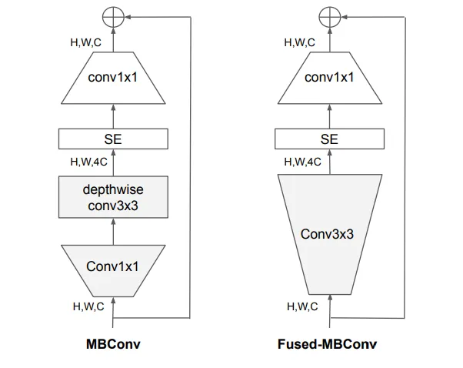
EfficientNet Algorithm

Slide 6
DATA PROCESSING
We need to convert the images to SMILES. But the images of chemical compounds are not available to convert them into SMILES.
Collected 10,000 SMILES for chemical compounds through ChemBL
Converted the SMILES into images using RDKit
Need to train the existing model using DECIMER with the images.
Since the data is large have trained the model in batches for all the 10,000 image.

Slide 7
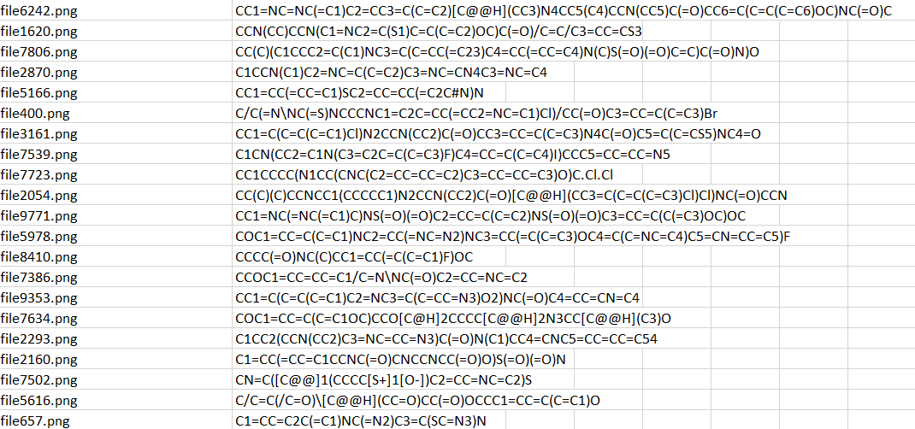
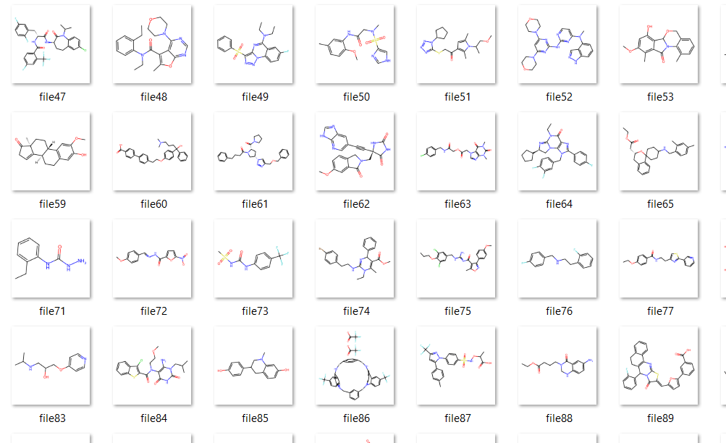

Slide 8
OBSERVATIONS
Need to check the accuracy of the model, to check if the SMILES generated are correct.
Since we already have the initial SMILES, can compare with that and check the efficiency.
We have created a sample of 100 test images which are different from the trained images, and have tried generating the SMILES from the images generated.
To check for accuracy, we generated the images of the output SMILES and observed that the same structure of Images is being generated. We have checked for all 100 images and we got the same result.
We can conclude that the model which we generated to convert Images to SMILES is 100% accurate.

Slide 9
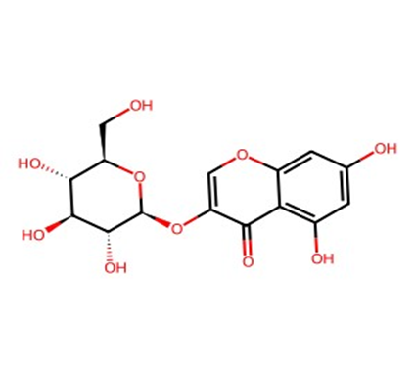
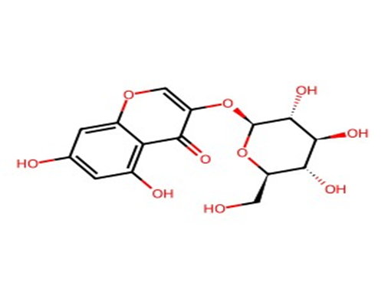
Result
Initial SMILE: O=c1c(O[C@@H]2O[C@H](CO)[C@@H](O)
[C@H](O)[C@H]2O)coc2cc(O)cc(O)c12
Decimer Output for the given image:
C1=C(C=C2C(=C1O)C(=O)C(=CO2)O[C@H]3[C@@H]
([C@H]([C@@H]([C@H](O3)CO)O)O)O)O

Slide 10
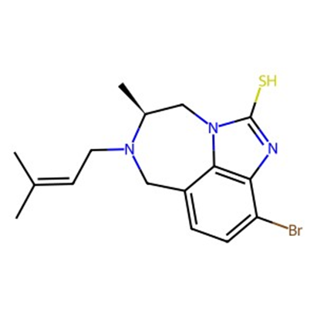
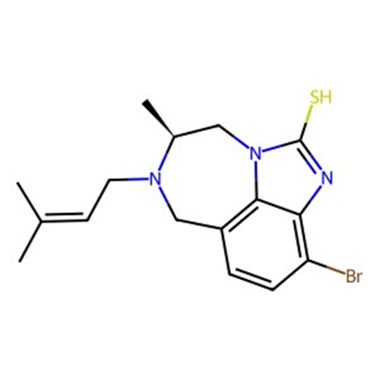
Initial SMILE: C[C@H]1CN2C3=C(CN1CC=C(C)C)C=CC(=C3N=C2S)Br
Decimer Output for the image: CC(C)=CCN1Cc2ccc(Br)c3nc(S)n(c23)C[C@@H]1C

Slide 11
WEB INTERFACE
We have developed a user interactive web interface where the user can upload the image of the chemical compound in any format and the Interface will generate the corresponding SMILES configuration of the given image.
The uploaded image is also used for further training of the model for the improvisation and build an efficient model by training with the inputs given by the user.

Slide 12
